Slide 1
Mini-Project #2 Application of Finite Element Analysis to a Simple Structural System
Moving analysis to the real world
Step 3: 2-1/2” Diameter Pole Design
Members: Barakkah Ibishomi

Slide 2
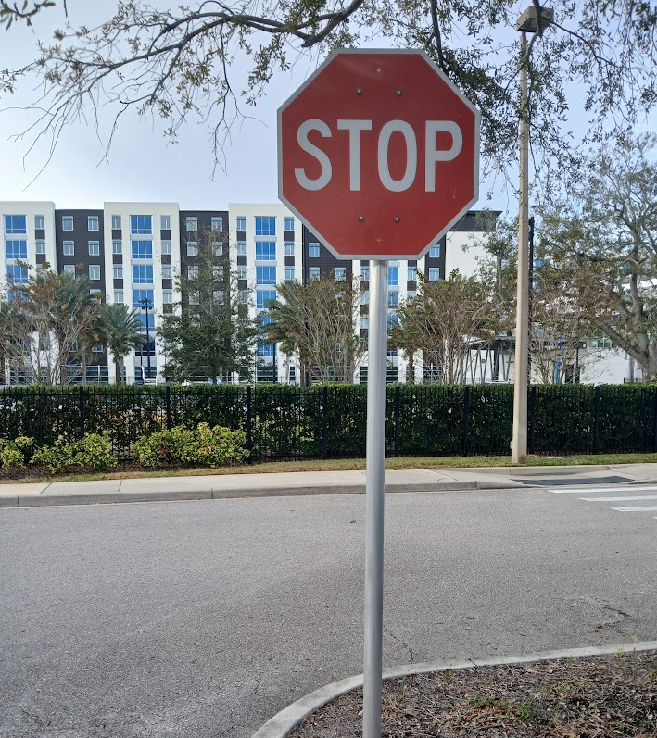
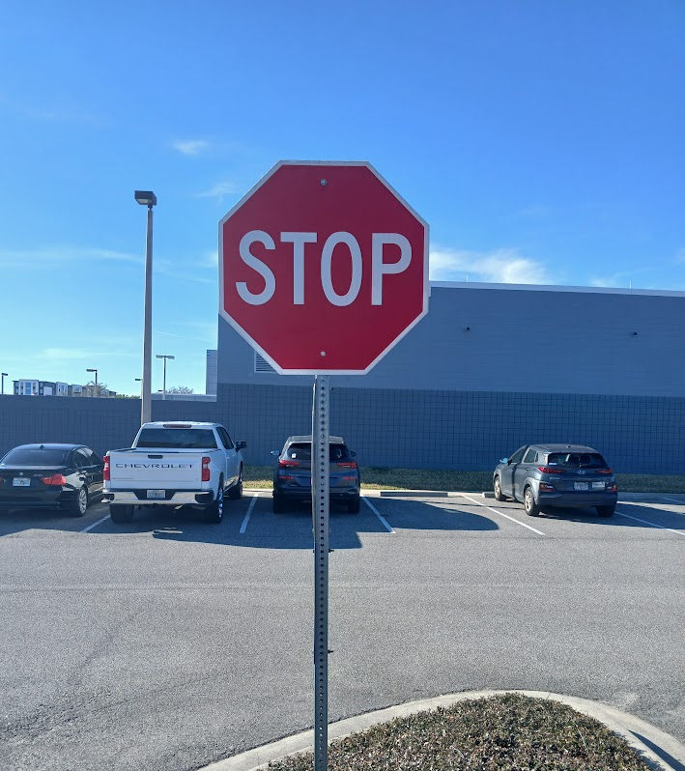
Context
We rely on them every day… the humble STOP sign.

Slide 3
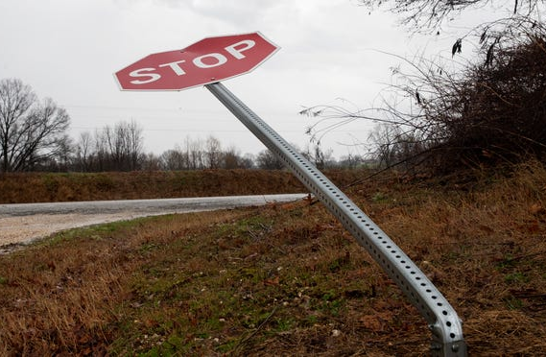
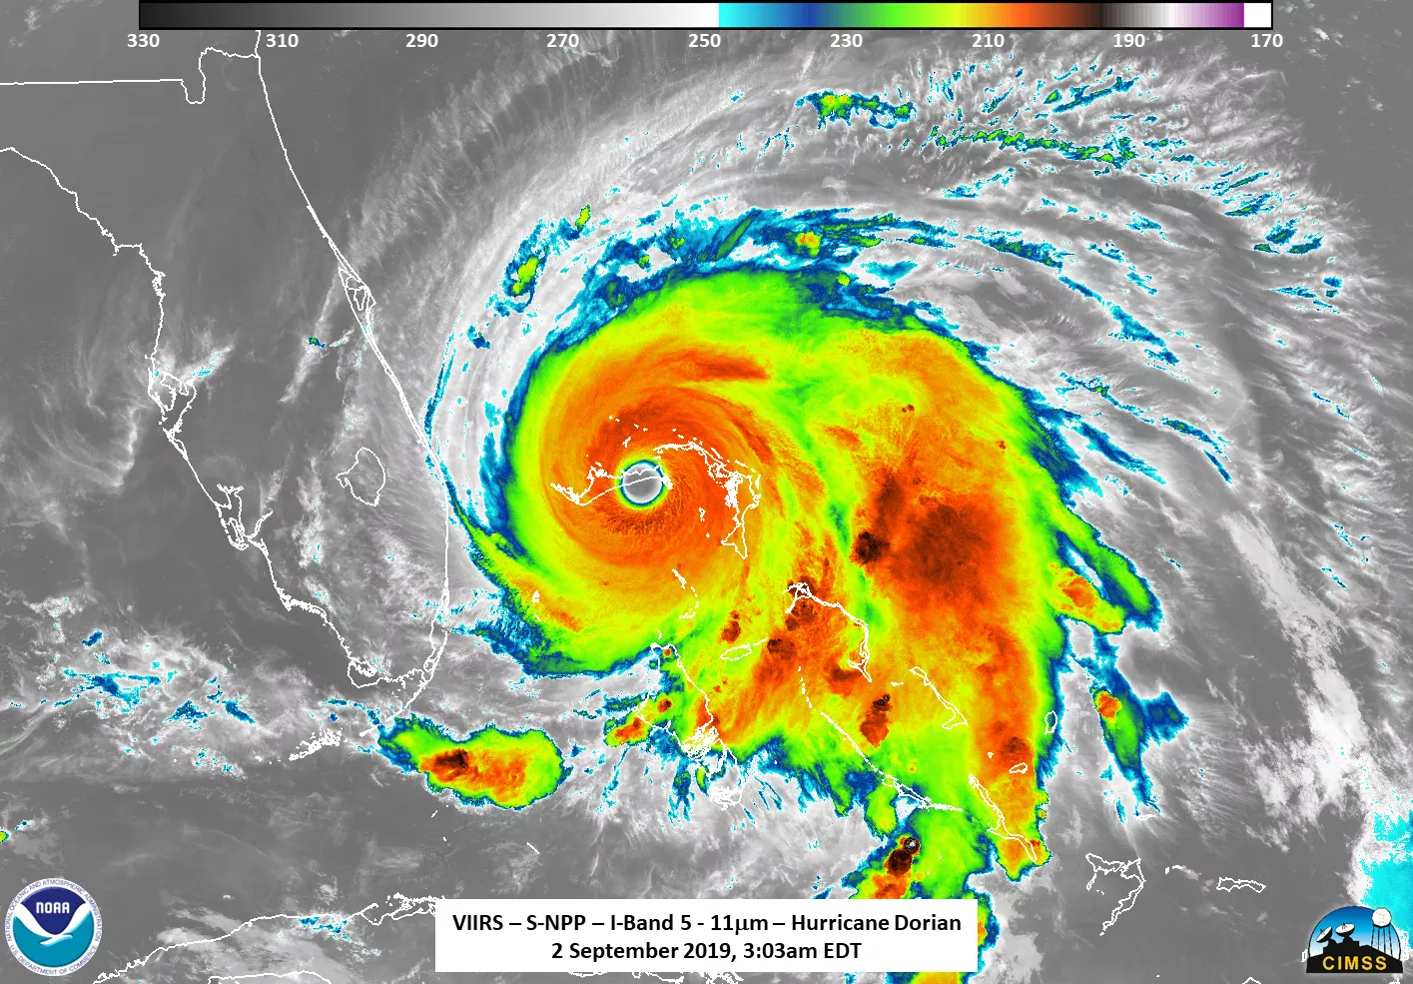

But, what if?
Could this happen here?

Slide 4
Steps to Completion
Step 1: Measure a STOP sign
Step 2: Estimate the wind load
Step 3: Design a 2-1/2” Diameter Pole Option
Step 4: Design a Galvanized Steel Rail Option

Slide 5
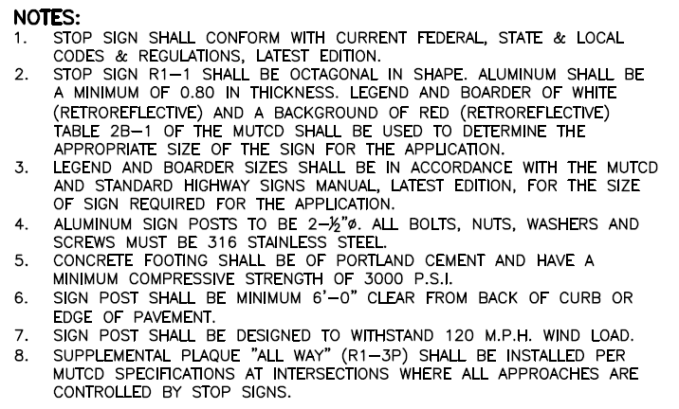
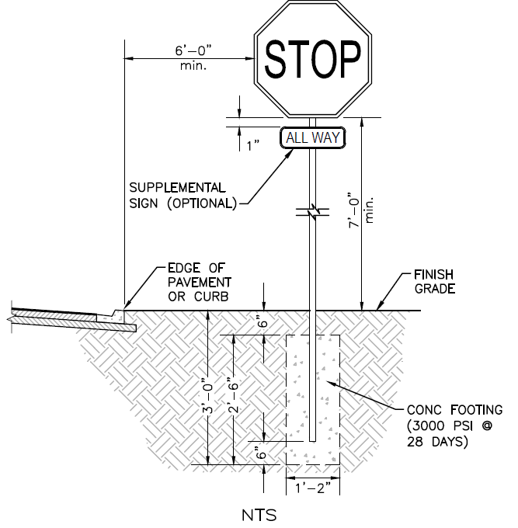


Slide 6
What are the Basic Elements Required by the City of Daytona?
Size of the sign meets MUTCD Table 2B-1 requirements
Aluminum Posts
2-1/2” in diameter
Resist 120 MPH wind speed

Slide 7
Requirements reasoning:
Sign Sizing: this requirement is enforced so that the stop signs are all consistently sized to ensure visibility, this helps to ensure that drivers are able to recognize and react accordingly should the need arise. If engineers were to use their own judgement, there could be cases of undersized signs, causing very high risk accidents especially on high speed roads
Structural Capability and material required: The diameter specified is to provide structural strength. Considering that Daytona beach is a coastal area, the material specified for use is to mitigate corrosion from seawater the 316 SS is has better resistance against seawater than standard steel does. If not specified, engineers may choose a cheaper options that corrode faster and cause the sign to collapse.
Wind Load design: Aside from corrosion, other downsides of Daytona being a coastal city is the risk of hurricanes and high winds. The city mandates that stop signs be designed for a wind load of about 120MPH to keep the poles intact during these periods. If engineers were to use their judgements, the poles might be under designed to save costs and that could lead to the poles becoming projectiles during a storm.

Slide 8
What are the missing pieces that we do need to specify to complete the design for the pole?
Specific type of Aluminum
Wall thickness of the 2-1/2” aluminum pipe

Slide 9

Material Selection
The Florida Department of Transportation (FDOT) also provides guidance (A LOT of GUIDANCE!!!) on the construction of roadway signage. https://fdotwww.blob.core.windows.net/sitefinity/docs/default-source/design/standardplans/2027/idx/700-010.pdf?sfvrsn=f2bf6d_2
The critical note:
So, we need to use ASTM B221, 6061-T6 alloy. What is that? See the following: https://compass.astm.org/content-access?contentCode=ASTM%7CB0221-21%7Cen-US

Slide 10
Requirements reasoning:
Material Properties for ASTM B221 6061-T6 Aluminum: Yield strength – 35,000psi (35ksi), Ultimate Tensile Strength: 42,000psi (42ksi)
Factor of Safety to be used: FS=2. This will be applied to the yield strength and not the ultimate strength because the yield strength is where permananet deformation begins, this is the failure condition for the pole. Even though the pole hasn't snapped, it is still permanently bent which is structural failure.

Slide 11
Structural Analysis – Let’s SCD(o) this!
Clear Problem Statement
Three Drawings
Conceptual Design (you already have this!)
What are you analyzing?
Simple Structural Model
Basic structural geometry
Free Body Diagram
Clearly illustrate the unknown external reactions
Narrated Solution
What are you trying to determine?
What are the constraints?
What are the basic assumptions?
What are the dimensions?
What are the loads?
Loads
Support conditions
Equations of Equilibrium
Governing stress equation(s)
Clearly identified results
Apply the SCD format to develop a concise set of engineering calculations that will allow you to specify the required wall thickness for the STOP sign support post.

Slide 12
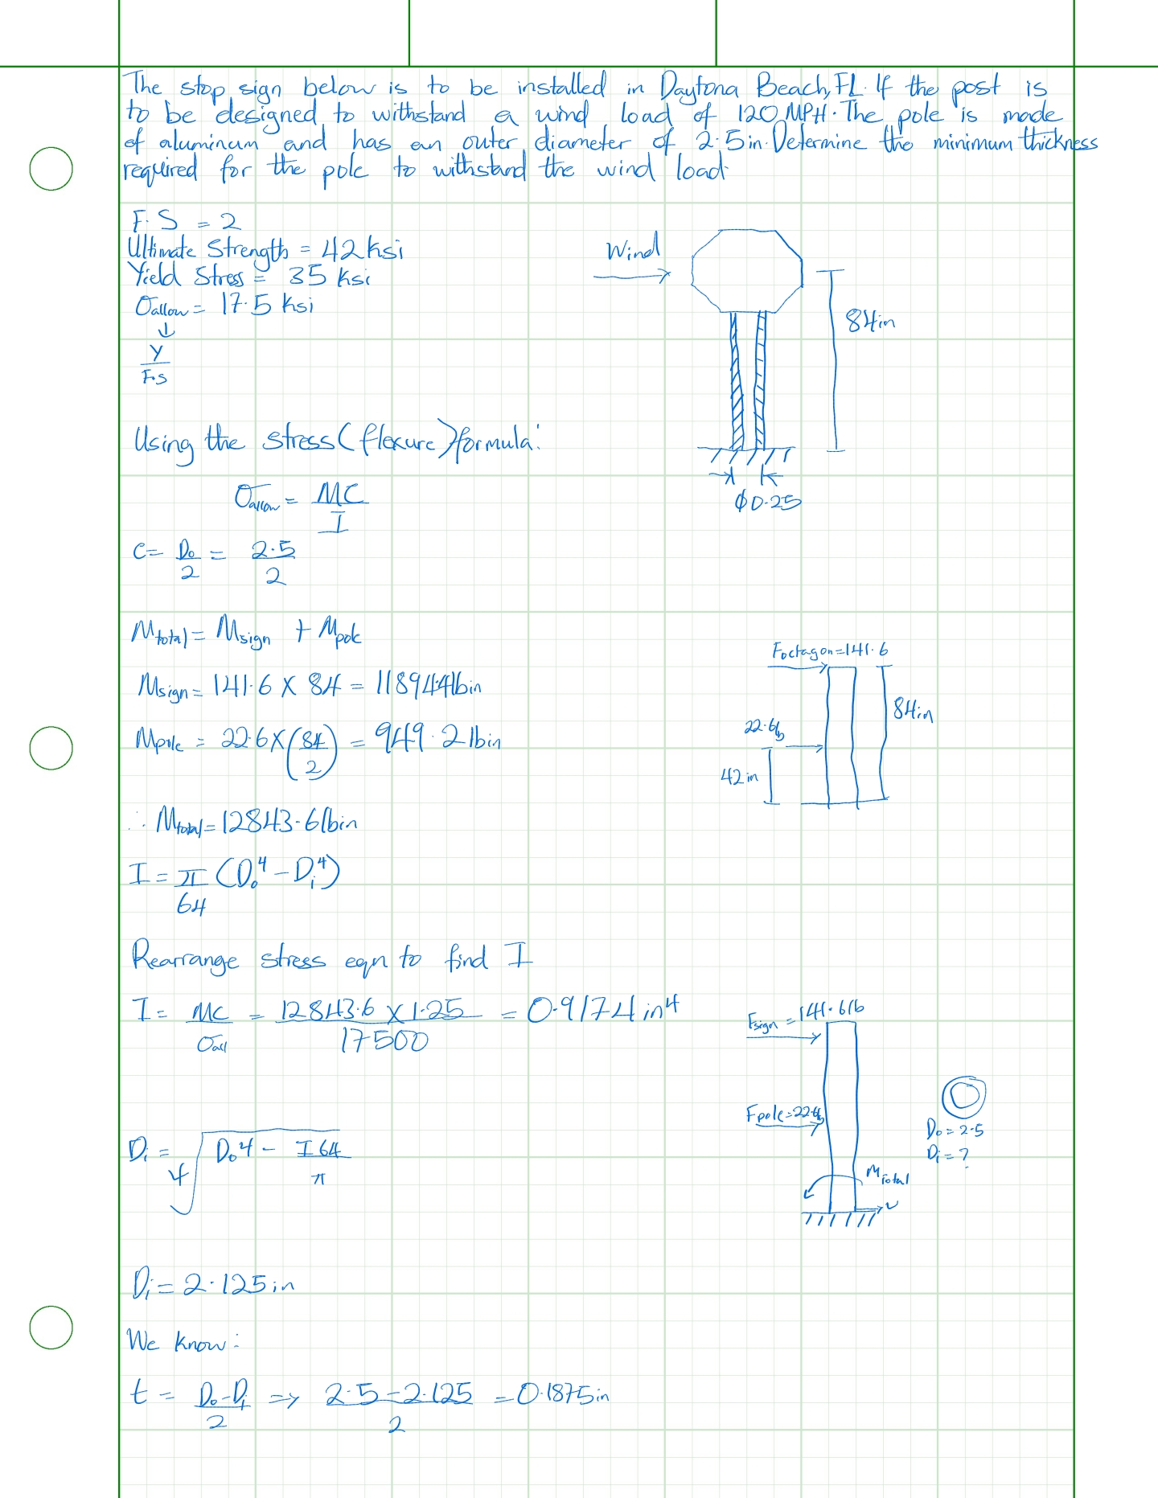
Insert Your SCD-Formatted Calculations Here. Be sure to clearly identify the minimum required wall thickness

Slide 13
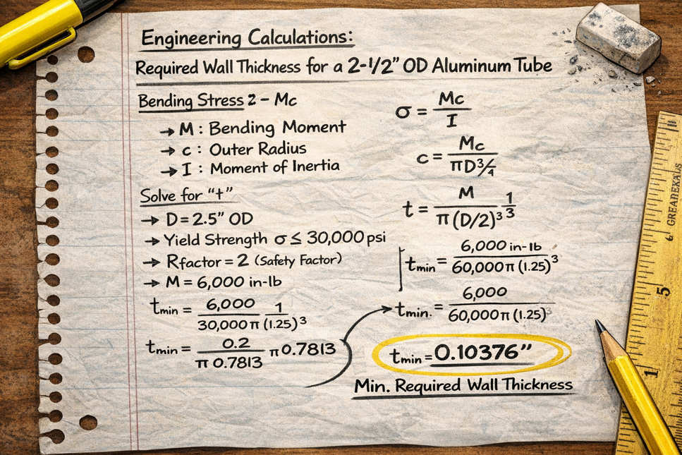
Specify the Pipe You Need (and can buy)
Hooray! You have determined the required minimum wall thickness…
Isn’t AI amazing? It may have just revolutionized solid mechanics! Or, more likely, it just made something up…
But, if we assume that the minimum required wall thickness is 0.10376” (your result may vary), what comes next?

Slide 14
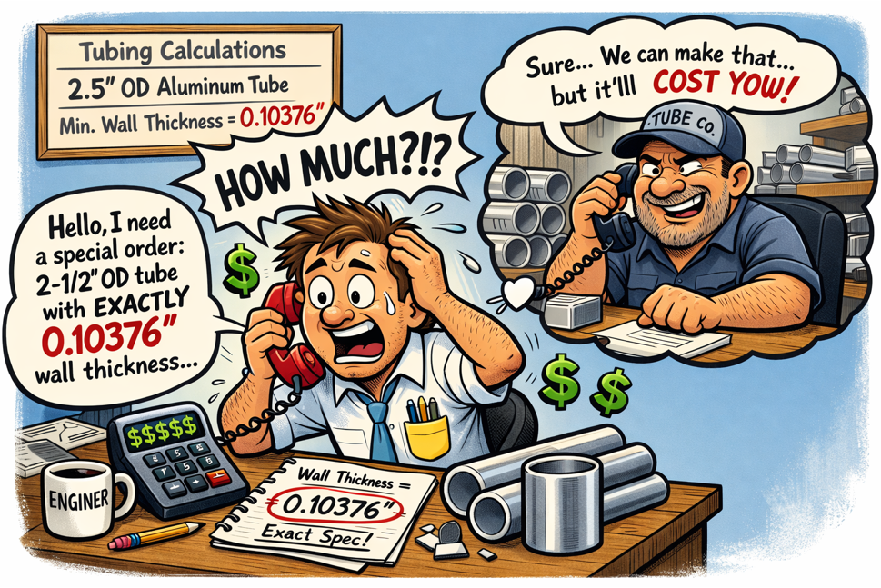
Specify the Pipe You Need (and can buy)
Hooray! You have determined the required minimum wall thickness…
Availability is always a critical factor driving the specification of structural components.
Use the following website to get started in identifying a suitable choice for your 2.5” OD aluminum tube: https://www.mcmaster.com/
Can’t find a tube that meets your length requirement? Try here: https://www.onlinemetals.com/

Slide 15
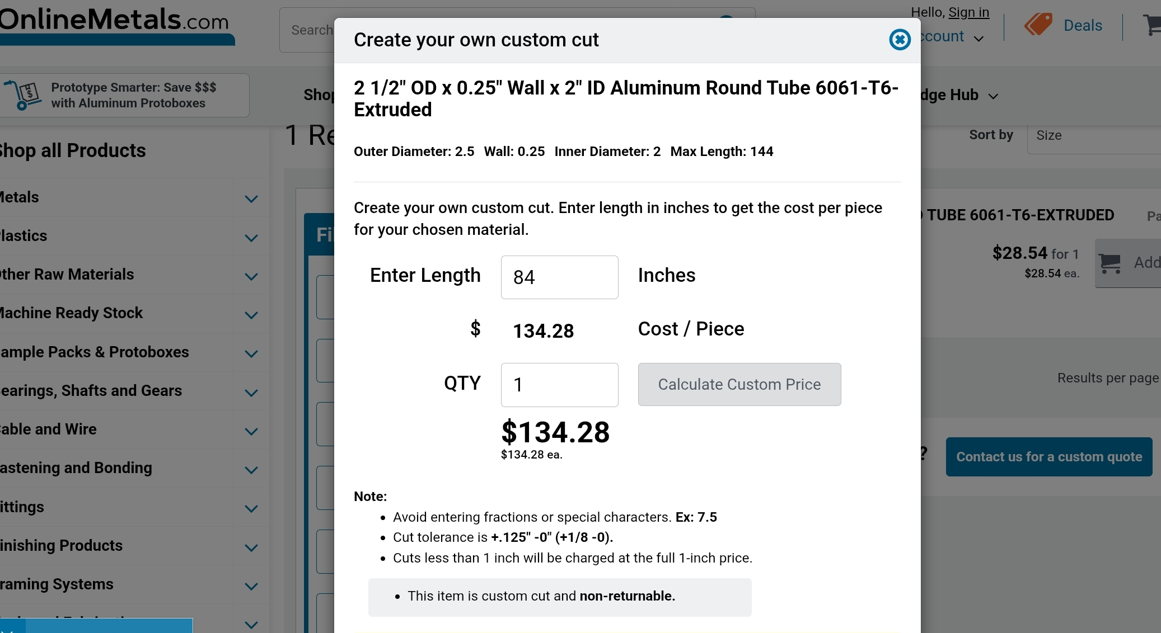
Specify your available stop sign post here. Clearly indicate the requirements for OD, ID, Wall Thickness, Length, and Material Type. Include a screenshot of where you would purchase this post and clearly indicate the total cost per post.

